Slide 1
“Simple” Bullet Hell Game
Harry Kim

Slide 2
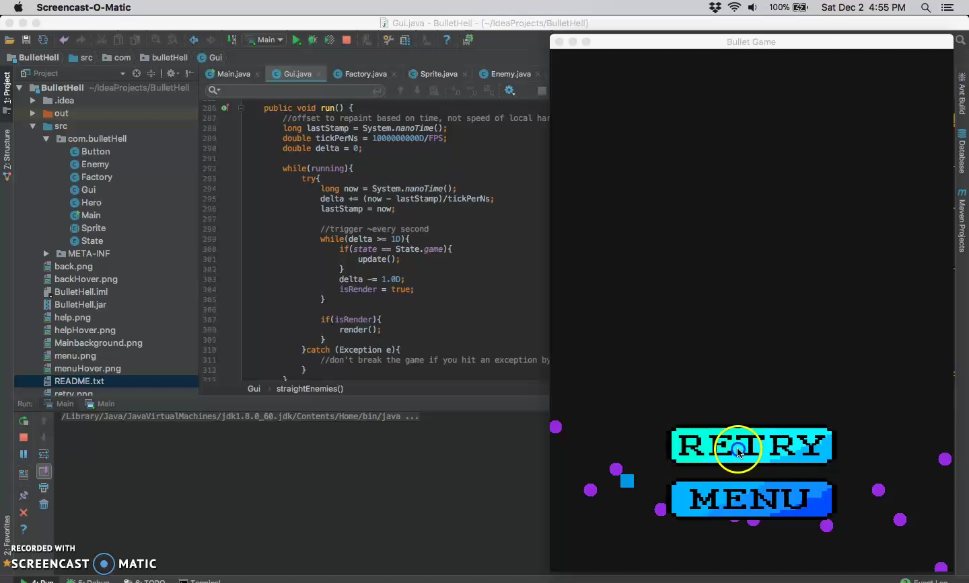
Conclusion: concurrent programming,
animation, and math are hard…

Slide 3
Summary: couldn’t fix lag
Listeners and Concurrent Programming? sucks ass to debug. Keylistener and MouseMotionListener did not register all the time… (mouse worked better than keys).
Animation Miscalculation? thought timing/spacing calculations were off (wasn’t).
Collision detection too heavy? No.
Perhaps, error in Polar to Cartesian conversion (having the circles travel on an angled path) with distance/time formula? (╯°□°)╯︵ ┻━┻
What was my solution?

Slide 4


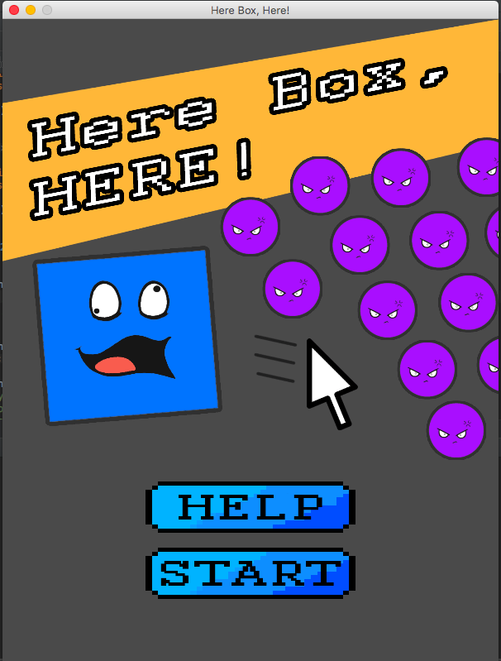
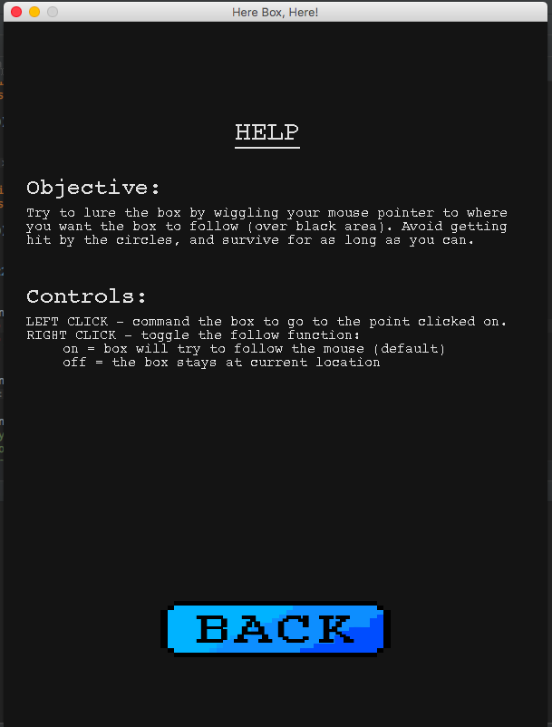
Bug … Mechanic
I like to think of this solution like finely aged cheese.
It spoiled and stinks, but relabeled with a higher price.

Slide 5
Turns out: it’s works Perfectly
The jar file runs without any lag what-so-ever. Turns out my Macbook is crappy and can’t handle a simple compile.

